Slide 1
Memoranda
Objectives
What is Memoranda?
Structure of Memoranda

Slide 2

Memoranda
Memorandum (singular) Memoranda (Plural)
Memoranda are brief, informal reports used to establish a record.
They generalize the communication process by transmitting the message from one or more authors to one or more recipients.
The memorandum is among the most versatile of organizational documents.
From brief reports to trip itineraries & introductions to proposals.
Used to communicate technical & administrative information.
Memoranda are written for numerous internal purposes:
request information,
make announcements,
outline policies,
transmit meeting minutes.
Memos are crucial to establishing a record of decisions, requests, responsibilities, results, and concerns.

Slide 3
Structure
Header: 1/8 of the memo
Opening, Context and Task: 1/4 of the memo
Summary, Discussion Segment: 1/2 of the memo
Closing Segment, Necessary Attachments: 1/8 of the memo

Slide 4

Formal Memorandum Template
To: [Audience] From: [Person and/or Department issuing the memo] Date: [Date Sent] Subject: [Subject of the Memo]
[Opening – Get to the point in the opening paragraph. Keep things simple and short. Make it easy and fast to read.]
[Summary – Provide enough background so all readers understand the history, but again, keep it simple.]
[Conclusion – End with a call to action.]
CC: [Send copies to anyone affected by the memo.] Attachments: [List any attachments to the memo. Only list items referred to in the body of the memo.]

Slide 5

Heading Segment
The heading segment follows this general format:
TO: (readers' names and job titles)
FROM: (your name and job title)
DATE: (complete and current date)
SUBJECT: (what the memo is about, highlighted in some way)

Slide 6

Opening Statement
Memo’s purpose is found in the opening paragraph and includes:
the purpose of the memo,
the context and problem,
and the specific assignment or task.
Before indulging the reader with details and the context, give the reader a brief overview of what the memo will be about
The introduction should be brief: approximately the length of a short paragraph.

Slide 7
Context
This is the event, circumstance, background of the problem you are solving.
Include only what reader needs, but be clear
Task Segment
Describe what you are doing to help solve the problem.
Include only as much information as is needed by the decision-makers in the context, but be convincing that a real problem exists

Slide 8
Summary Segment
If your memo is longer than a page, you may want to include a separate summary segment.
Discussion Segment
The discussion segments are the longest portions
Closing Segment
Closing with a courteous ending that states what action you want your reader to take.
This section is not necessary for short memos and should not take up a significant amount of space.
This segment provides a brief statement of the key recommendations you have reached.
Includes all the details that support your ideas.
The discussion segments include the supporting ideas, facts, and research that back up your argument in the memo.
If this section is inadequate, the memo will not be as effective as it could be.
Make sure you consider how the reader will benefit from the desired actions and how you can make those actions easier.

Slide 9
TO: Kelly Anderson, Marketing Executive
FROM: Jonathon Fitzgerald, Market Research Assistant
DATE: June 14, 2007
SUBJECT: Fall Clothes Line Promotion_________________________________________________________________
Market research and analysis show that the proposed advertising media for the new fall lines need to be reprioritized and changed. Findings from focus groups and surveys have made it apparent that we need to update our advertising efforts to align them with the styles and trends of young adults today. No longer are young adults interested in sitcoms as they watch reality televisions shows. Also, it has become increasingly important to use the internet as a tool to communicate with our target audience to show our dominance in the clothing industry.
Internet Advertising
XYZ Company needs to focus advertising on internet sites that appeal to young people. According to surveys, 72% of our target market uses the internet for five hours or more per week.
Television Advertising
It used to be common to advertise for our products on shows like Friends and Seinfeld for our target audience, but even the face of television is changing. Young adults are tuning into reality television shows for their entertainment. Results from the focus group show that our target audience is most interested in shows like American Idol, The Apprentice, and America's Next Top Model.

Slide 10
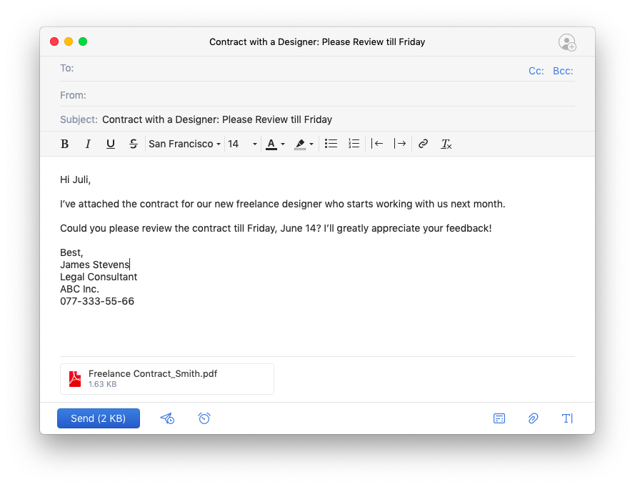
Are emails a type of Memo?

